Slide 1

Socialites Hub- Networking for Welfare
SAD Project
Team members:
Kriti Singhal (IPG-2014050)
Evi Agarwal (IPG-2014108)
Mona Singh (IPG-2014056)
Under the Guidance of-
Dr. Anurag Srivastava

Slide 2
Social Media – Influencing People
Social media is everywhere.
From production and management of services to workforce development and community engagement strategy, social media tends to have an ever increasing potential.
Social media has become ingrained in society.

Slide 3
PROBLEM STATEMENT
People willing to serve humanity couldn’t find ways and proper guidance to do so.
Also, many social clubs need large amount of contributors (individuals or other such social clubs) in their locality to assist and aid them.
Many a times people who are the most down at heel remain deprived of the social services provided by the charity givers.

Slide 4
Social Media
Social Workers
Socialites Hub

Slide 5

Socialites Hub is an online community of philanthropists, charity clubs and various other do-gooders worldwide. The application provides a platform for all such people to collectively function and accomplish the task of service to humanity.
Our Solution:
Socialites Hub-
Networking for Welfare

Slide 6
Purpose
Creates an opportunity to people residing in different areas to collectively organize charity events.
Provides a medium to spread awareness among the underprivileged ones.
Allows people with benevolent feelings to locate “people-in-need” areas of different cities in order to provide a helping hand to them.

Slide 7
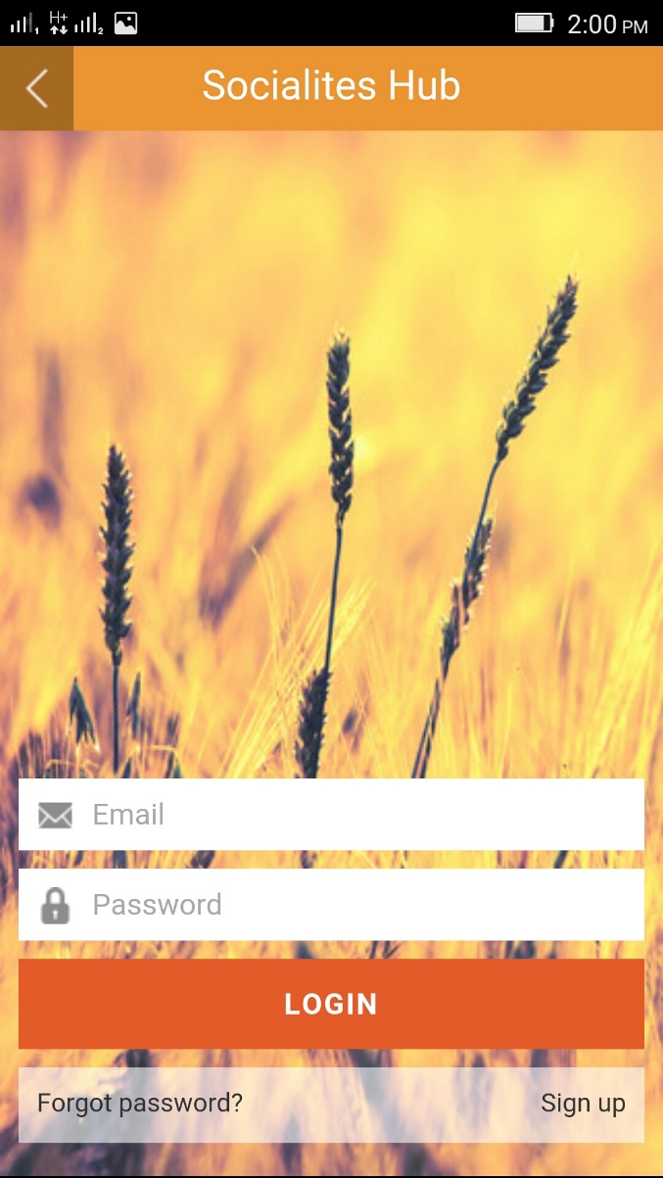
Product Description
We are introducing an application that would serve as a hub for carrying out all social care and welfare activities.
Users create public profiles by signing up.
Cities and issues of interest are asked.

Slide 8
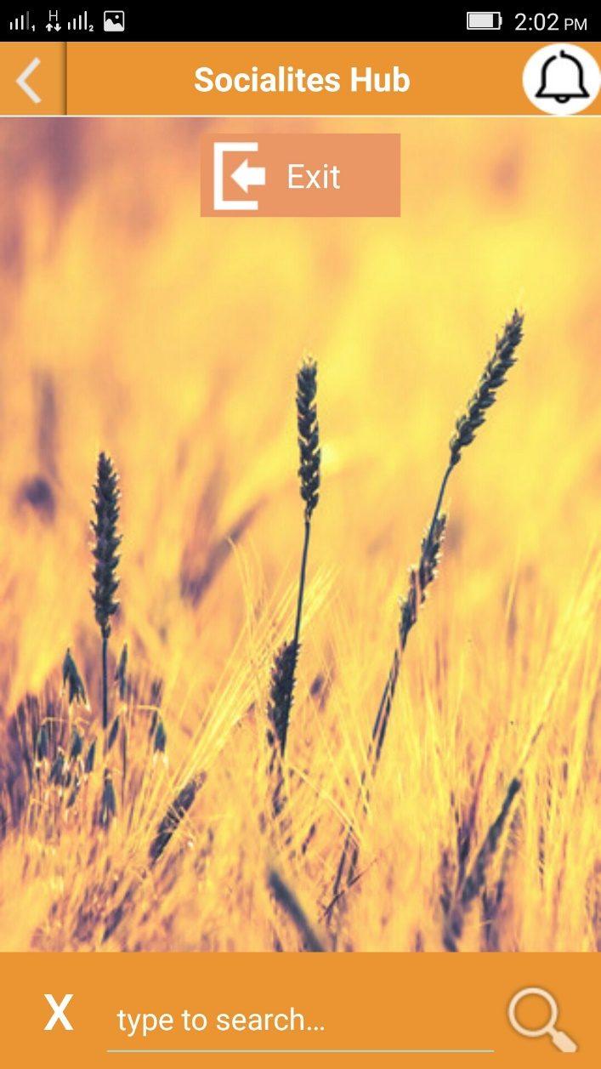
Notification
A search bar at the bottom of the app page.
Provision of filters for each tab page.
Filters include date, issue, city etc.
Reminders will be sent as notifications.
Search Bar

Slide 9
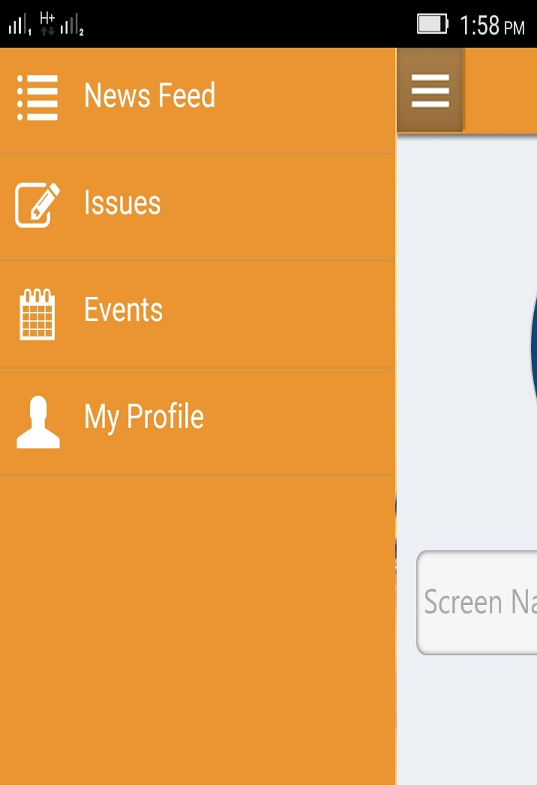
The application design features four tabs:
News Feed
Issues
Events
My Profile.

Slide 10
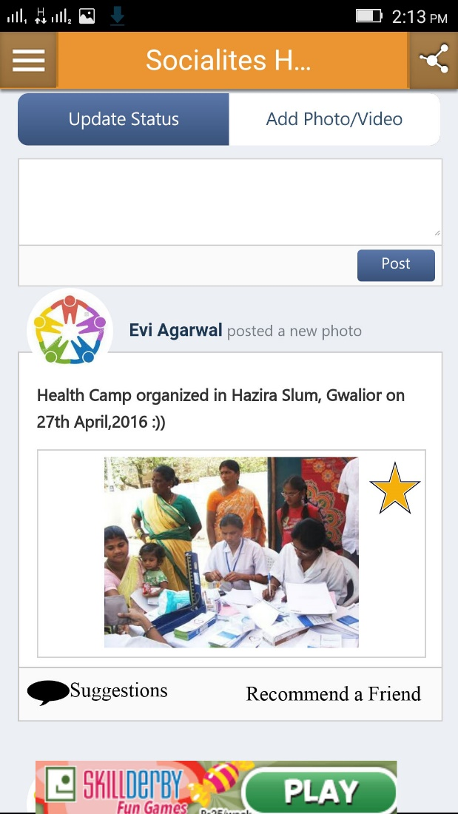
News Feed
News Feed displays the constantly updating list of stories in the home page.
Every post in the News Feed contains:
Recommend a Friend
Suggestions
Favorites

Slide 11
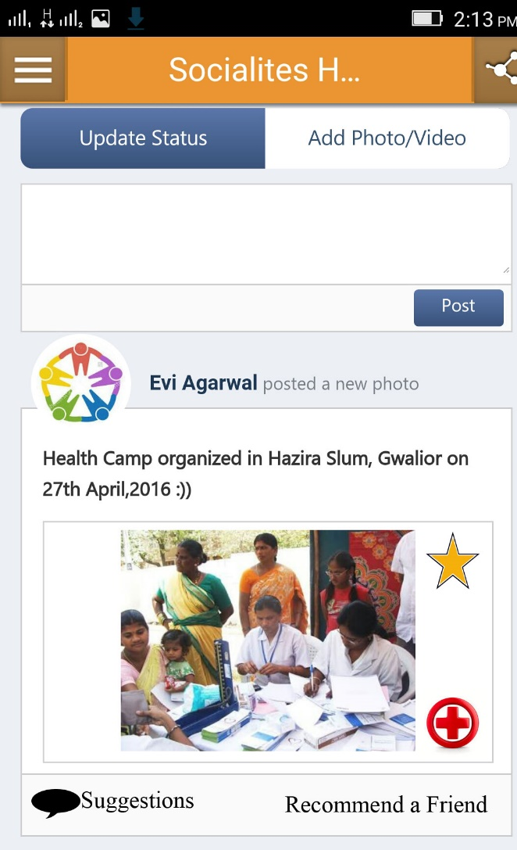
Issues tab
Displays all the problems posted by the users.
A problem posted contains:
Recommend a friend
Suggestions
Favorites
Create an Event

Slide 12

Events Tab
All the events being organized by the users will be listed under Event tab.
Events post contains:
Recommend a Friend
Suggestions
Favorites
Join the Event

Slide 13
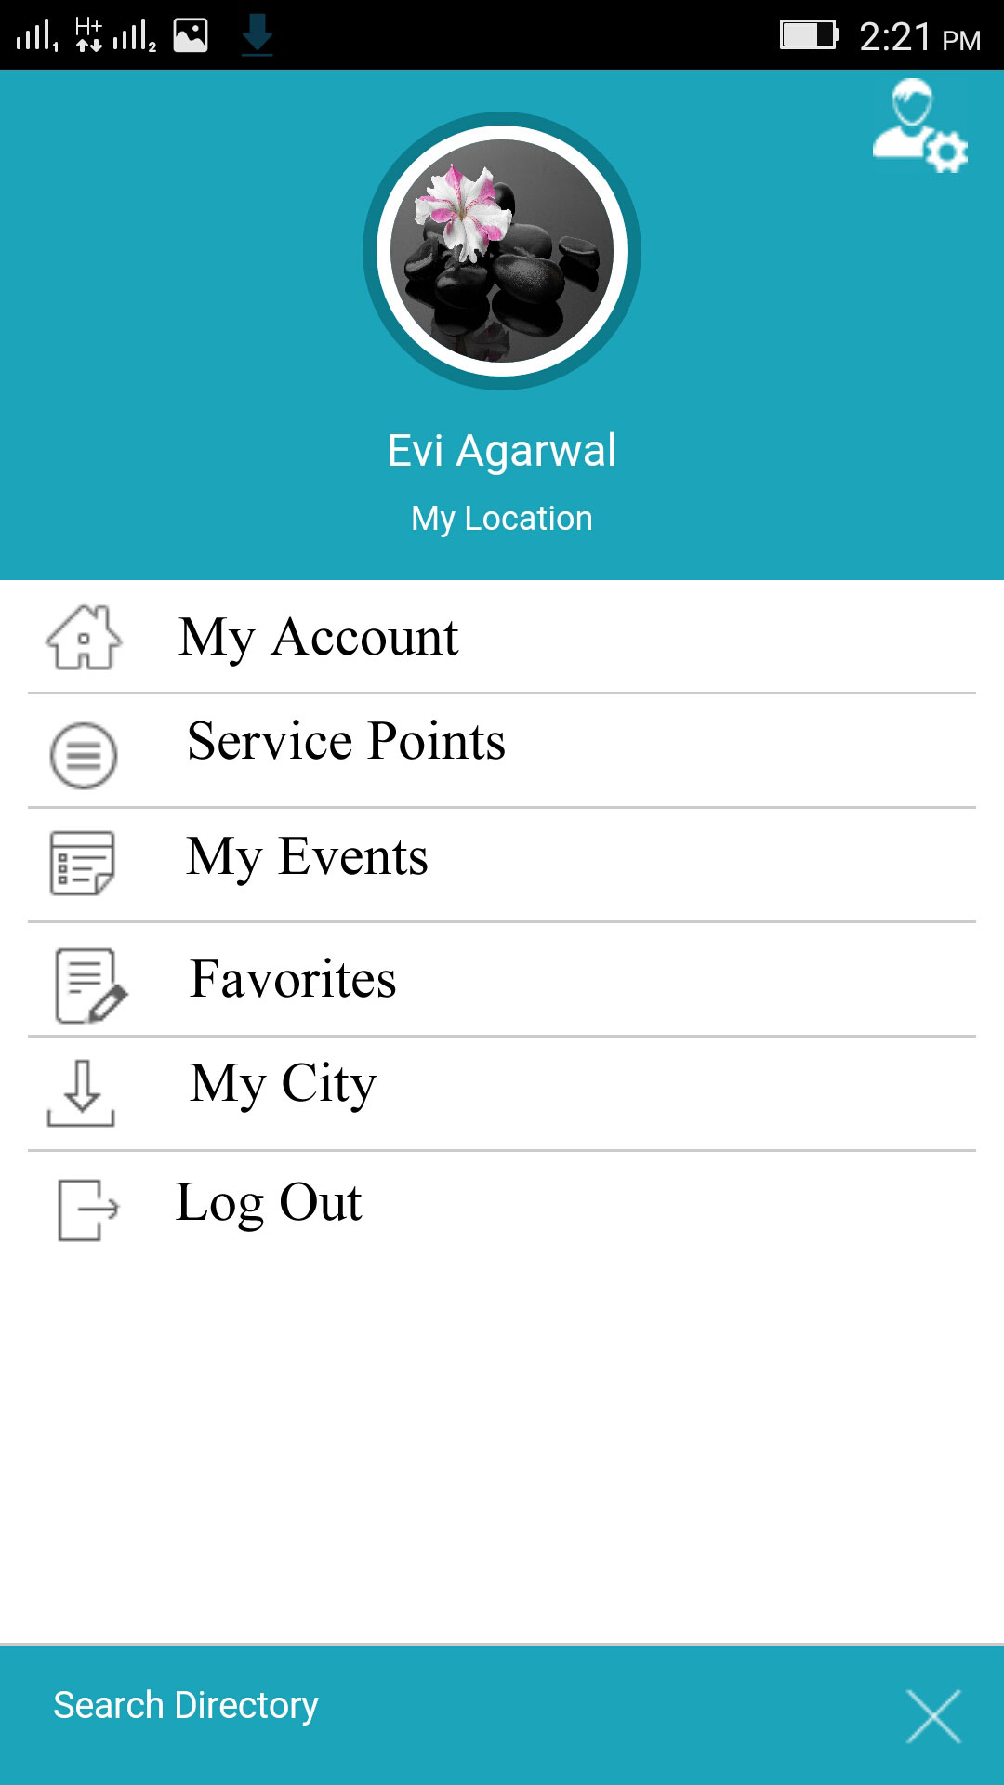
My Profile
Contain user’s account details and settings such as no. of friends, cities and issues of interest.
Users can send friend requests to each other and also can avail the chat facility.

Slide 14
Some Special Characteristics…
A personal city page will list all the activities, posts, stories, issues and events related to the city.
City page contains a database of orphanages, old age homes, and polluted areas of the cities as well.

Slide 15
Some Special Characteristics..
Person with highest ‘Service Points’ gets to become “City Ambassador”.
Service Points are the credits earned by the users, based on their active participation.
Service points act as a measure of the social contribution, motivating and creating competitive environment.

Slide 16
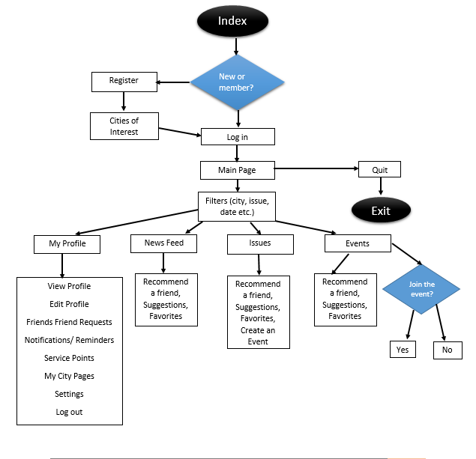
Overview Flowchart

Slide 17
User Classes
The product can be used by people of any educational level, experience and technical expertise.
The anticipated users of the application are all public-spirited, humanitarian and charitable people.
The individual may or may not be a part of any social service club.

Slide 18
Product Perspective
The idea of the development of the Socialites Hub evolved by taking into consideration the problems faced by various college level social clubs in organizing events which requires reaching out to mass and involve their participation. Hence, a technology with solutions of above mentioned problems was created.

Slide 19
BENEFIT AS A MOBILE APPLICATION
People favor apps due to its convenience, speed and ease of use.
Number of target audience increases due to increased promptness.
Contains database of all the orphanages or old-age-homes which can be accessed anywhere due to the mobile’s portability.

Slide 20
Thank You

